Slide 1


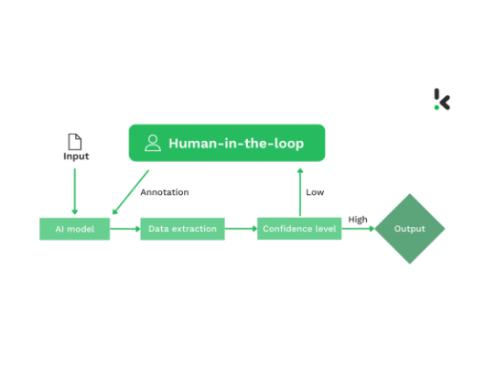
Iterative Refinement via Investigator Feedback
The model improves through structured collaboration with the FIU.
Phase 1 used internal data for initial model development.
Phase 2 samples ~500 cases for independent investigator validation.
Expert feedback provides validated labels for model retraining.
Structured loop improves detection accuracy and reduces false positives.

Slide 2






Measuring Detection Effectiveness
Focus: Is the model right, stable, and useful?
Model Development
Stability Monitoring
Production Effectiveness
AUC-PR and KS separation statistics ensure initial model quality.
Population Stability Index (PSI) monitors score distribution drift over time.
Precision@N measures relevance of top-surfaced alerts for analysts.
"Is the model finding the right signals?"
"Is the model still performing as expected?"
"Are the alerts actually useful to analysts?"
Statistical significance testing applied during comparisons.
Unlabeled data scoring allows for continuous drift detection.
Directly maps to operational efficiency and workload.

Slide 3




Real Detection Examples
Indicators for review — not conclusions of activity.
"cocaine money"
Direct substance reference; high-confidence keyword match.
"Payment for cost of MDMA"
Explicit controlled substance; transactional phrasing match.
"You folks want to buy some heroin?"
Solicitation language; semantic similarity to drug patterns.
"Fentanyl re-up"
Specific resupply slang; contextual flagging for risk.

